Slide 1
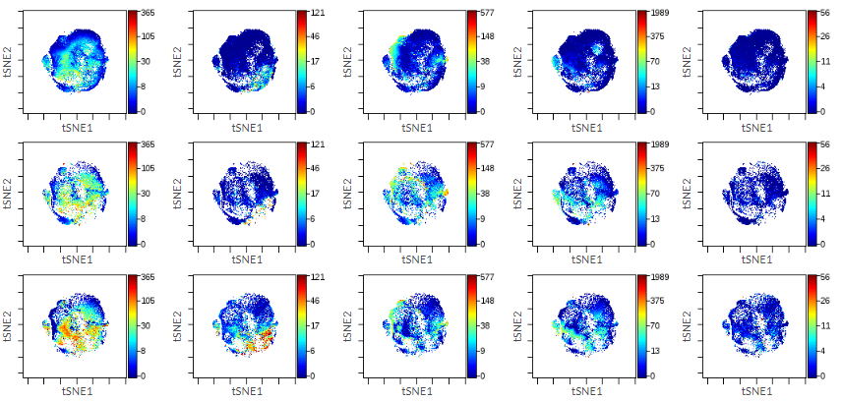
CD3⁺ CD4⁺ CD183⁺
CD3⁺ CD4⁺ T-BET⁺
CD3⁺ CD4⁺ CD194⁺
CD3⁺ CD4⁺ CD196⁺
CD3⁺ CD4⁺ GATA-3⁺
CLASSICAL TH1 - CD3 ⁺, CD4 ⁺, CD183 ⁺, T-BET⁺
NON-CLASSICAL TH1 - CD3 ⁺, CD4 ⁺, CD183 ⁺, CCDR6⁺ , T-BET⁺
TH2 - CD3 ⁺, CD4 ⁺, CD194 ⁺, GATA-3⁺

